Slide 1
SSN SSN MENTORING SYSTEM MENTORING SYSTEMSSN MENTORING SYSTEMENTORING SYSTEM
ARUNASREE,
ARJUN
ARSHAT PARVAES,
ARUNKUMAR,
ASHWIN,
BADRI NARAYANAN

Slide 2
2
EXPECTED DELIVERY:
till the first week of august
PROBLEM STATEMENT
AN ORGANISATION lIKE SSN COLLEGE OF ENGINEERING WANTS TO DEVELOP A MENTORING SYSTEM. A MENTOR SHOULD BE ABLE TO VIEW ALL THE MENTEES ASSIGNED TO THEM. ON SELECTING A MENTEE, THE MENTOR SHOULD BE ABLE TO ADD /DELETE /UPDATE THE MENTEE DETAILS. THE MENTOR MAY SCHEDULE A MEETING WITH A MENTEE AND SHOULD BE ABLE TO CAPTURE THE MEETING DETAILS LATER. A MENTEE SHOULD BE ABLE TO SEE ONLY THE THEIR DETAILS, EXCEPT FOR THE CONFIDENTIAL INFORMATION ENTERED BY THE MENTOR. A MENTEE SHOULD BE ABLE TO REQUEST FOR A MEETING WITH THE MENTOR THROUGH THIS SYSTEM. THE MANAGER SHOULD BE ABLE TO GENERATE VARIOUS REPORTS FROM THESE MENTEE RECORDS.
Recent progress
LOGIN SCREEN
DATA COLLECTED
MENTEE,MENTOR AND MANAGER PORTAL CREATED
SCHEDULING SYSTEM DEVELOPED
risk
CONNECTION OF TKINTER WITH THE BACK-END

Slide 3
REQUIREMENTS
R-1: A mentor should be able to view all the mentees assigned to them.
R-2: Mentor should be able to add/delete/update the mentee details.
R-3: Platform to allow a mentor to schedule a meeting with a mentee and capturing meeting details later.
R-4: A mentee must see only his/her details, except for the confidential info. entered by mentor.
R-5: A mentee should be able to request for a meeting with the mentor through this system.
R-6: The manager should be able to generate various reports from these mentee records.

Slide 4
ROLES
Product owner: Badri narayanan
Scrum Master: Arunkumar
Scrum Team: Developers-
1.Arjun
2.Arshat
3.M.Ashwin
Tester-Arunasree

Slide 5
REQUIREMENTS ASSIGNED
FRONT-END:
1.ARUN
2.ASHWIN
TESTER:
1.ARUNASREE
BACK-END:
1.Mentee requirements-badri narayanan
2.mentor requirements-Arjun
3.manager requirements-Arshat

Slide 6
Report and Meeting
TASK ASSIGNMENT:
Three SCRUM Meetings were held to address the different tasks of each member of the team
Tasks were assigned for all the members of the team by looking into their strengths and weaknesses
USER STORY:
The requirements of the clients were analysed and user stories were created
User stories will help us visualise the requirements better

Slide 7
Front End (GUI)
Login screen:
Login buttons and Back buttons were added for login purpose and to facilitate the usage of our portal
So that a mentor,mentee or manager may access our mentoring system easily and securely with their appropriate username and password
Background and logo:
By taking inspiration from the SSN mentoring system we have added a relevant background and a SSN logo
This screen is the first screen of our app

Slide 8
Back End (AVL)
Login screen :
Buttons were added for the login screen
So that a mentor,mentee or manager may access our mentoring system easily and securely with their appropriate username and password
Background and logo :
By taking inspiration from the SSN mentoring system we have added a relevant background and a SSN logo
This screen is the first screen of our app

Slide 9
Attention areas
Risk1(AVL Tree):
We have to learn about the data structure AVL tree to store and access the data corresponding to each mentor,mentee, and the manager
Risk 2(LINKING) :
The knowledge about the process of linking the GUI interface with the classes need to be acquired

Slide 10
CLIENT INTERACTION
Mentor :
Had individual discussion with two faculties.They agreed but due to insufficient time we couldn’t get requirements from them
Mentee :
We sent form to more than 100 students and we got 21response
Manager:
Had discussion with IT- HOD

Slide 11
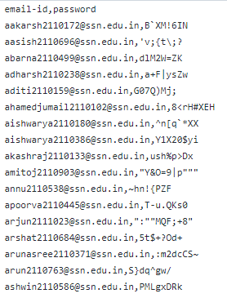
Sample file containing credentials of mentees

Slide 12
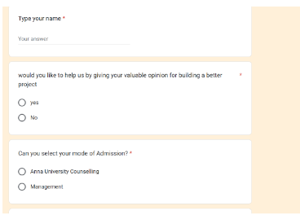
A Google form was created to get user input from mentees:

Slide 13
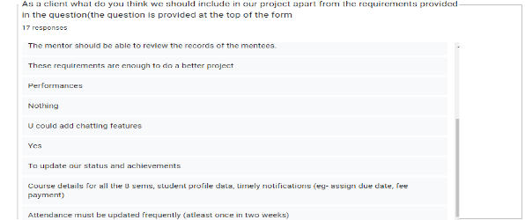
Some of the requirements collected from users (mentees) are :

Slide 14
OBJECTIVES OF YOUR PROJECT:
→To improve the efficiency of the current mentoring system and to make it more user friendly.
→To make conducting meetings between mentors and mentees easier.
→To make it possible for the mentor to be able to view all subjects’ marks for a particular mentee

Slide 15
FUNCTIONAL COMPONENTS
Tkinter module
Individual username and password
Mentor/Mentee records
Mentors can modify the data of any particular mentee
Scheduling meeting when required

Slide 16
NON FUNCTIONAL COMPONENTS
Hiding password/ ensuring password is strong
AVL Tree for storing data
Hash Table for checking credentials
Linked List for adding data
Arrays to store CAT-1 and CAT-2 marks
Hiding the confidential details entered by mentors from mentees

Slide 17
SCHEDULING SYSTEM:
Scheduling system has three portal/facilities given. They are ZOOM , EMAIL SENDER , CHATBOT.
ZOOM zone for using zoom platform for scheduling an online meeting with the mentor when required.
EMAIL SENDER to facilitate sending an e-mail to the mentee and the mentor from a common email address
CHATBOT is added through which the mentee and mentor are offered a personnel chat option and to contact each other when there is a requirement for a meeting.
Tool used for setting up meeting: Pyjwt, json, requests and time libraries in python. The zoom API tool has been used to generate a random meeting link and a password for the same. This will be displayed on the app GUI.
The same tool is used to retrieve meeting details that are displayed by default on zoom.

Slide 18
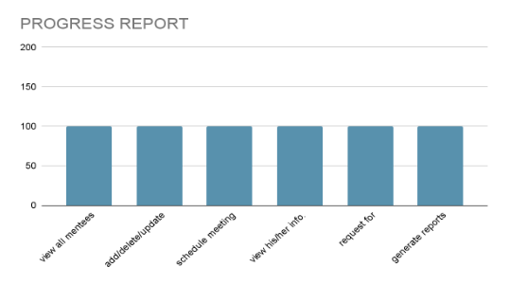
What we have completed so far

Slide 19
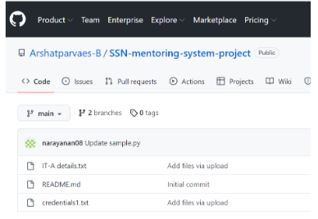
GitHub was used for project collaboration along with jira:

Slide 20
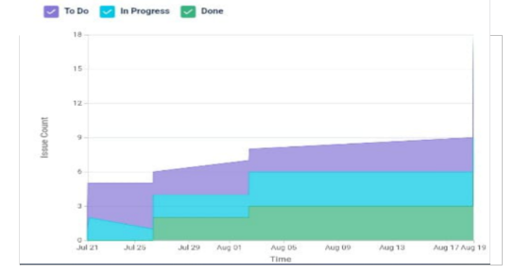
JIRA track

Slide 21
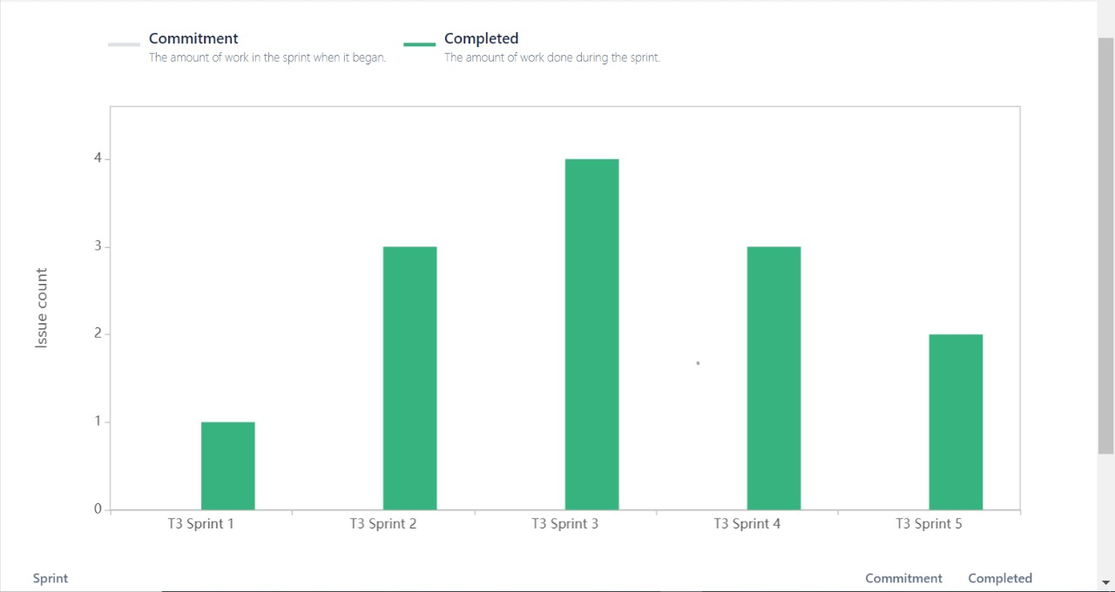
VELOCITY REPORT :

Slide 22
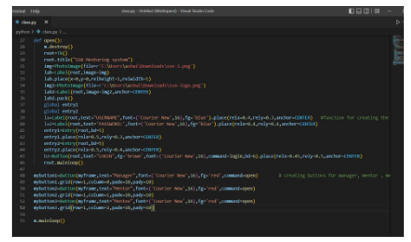
Code Snippet for Main Screen

Slide 23
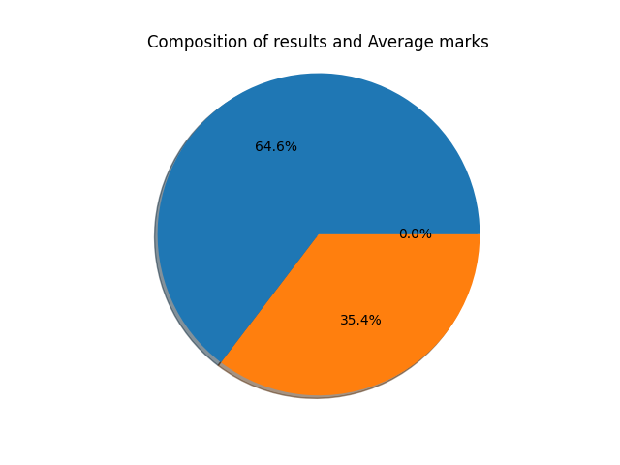
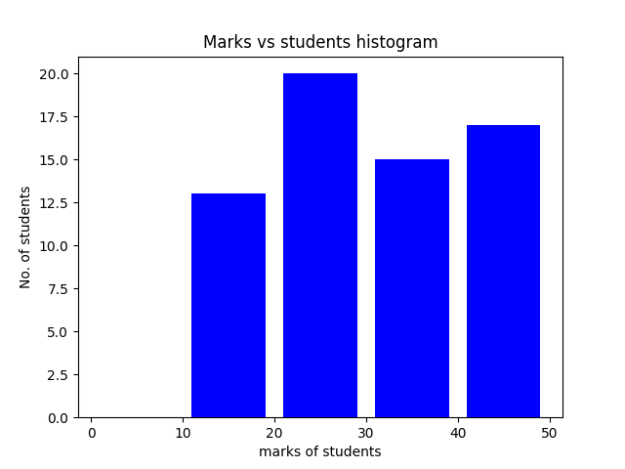
Manager Reports
Manager Reports

Slide 24
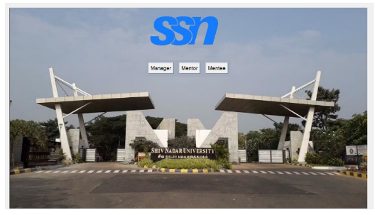
OUTPUT: Main screen

Slide 25
Demo Video:

Slide 26
THANK YOU

